Slide 1

Pairs of Linear Equation
in two Variable
Anurag Vijay

Slide 2
Contents
Introduction
Graphical Representation
Algebraic Method
Equation reducible to pair of linear equation in two variable.
Summary

Slide 3

Equation
Linear Equation
Linear Equation in One Variable
Linear Equation in Two Variable

Slide 4
Linear Equation In Two Variable
Expressed using two variable
Can have infinite nos. of solution
General form of representation is:-
Here above a and b both are non zero
 e.g. -

Slide 5
Every linear equation can be plotted on graph
Each solution to a linear equation correspond to a point on line representing the equation

Slide 6
Pair Of Linear Equation In Two Variable
*
 General form of representation is:-
They have same two variable
They can be solved by- a)Graphically b)Algebraically

Slide 7
Graphical Method
 Pair of linear equation in two variable is represented by two lines. There are three possibilities-
If lines intersect at a point
Consistent
equation
Unique
solution
If lines coincide
Dependent equation
Infinite solution
If lines are parallel
Inconsistent equation
No solution

Slide 8




In
&
we have:-
Compare ratios
Representation
Consistent equation
Parallel equation Inconsistent Equation

Slide 9


Examples
 2x + 3y = 9
4x + 6y = 18
(1)
(2)
 These solutions are given below:-
x | 0 | 4.5
 | 3 | 0
x | 0 | 3
 | 3 | 1
Table-1

Slide 10
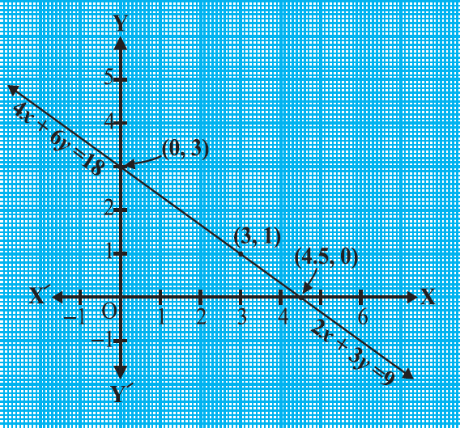

Slide 11
Algebraic Method
There are three methods to find solution for pair of linear equation in two variable-
  Substitution method b)Elimination method
c)Cross-multiplication method

Slide 12
Substitution Method
Find value of 1st variable in terms of 2nd variable in either equation.
Substitute the value of 1st variable in 2nd equation& reduce it to find value of 2nd variable.
Now with value of 2nd variable find out the value of 1st variable

Slide 13
Examples
 7x – 15y = 2
x + 2y = 3
Then,
x + 2y = 3 x = 3 – 2y
(1)
(2)
– 29y = –19
Therefore, y =
Then, Substitute this value of
y in Equation (3)
x=
(3)
Now, Substitute the value of
x in Equation (1).
7(3 – 2y) – 15y = 2
21 – 14y – 15y = 2

Slide 14
Elimination Method
Make the coefficient of any one variable in both the equation common.
Now add or subtract the two equation to eliminate the common variable.
Solve the equation to get the value of 2nd variable.
 Now using the value of 2nd variable find the value for 1st variable.

Slide 15
Examples
 9x – 4y = 2000 (1)
7x – 3y = 2000 (2)
Then, make the coefficients of y equal.
27x – 12y = 6000 (3)
28x – 12y = 8000 (4)
Subtract Equation (3) from Equation (4)
(28x – 27x) – (12y – 12y) =
8000 – 6000
x = 2000
(28x – 27x) – (12y – 12y) =
8000 – 6000
x = 2000
Substituting this value of x in (1), we get
9(2000) – 4y = 2000
y = 4000

Slide 16

Cross Multiplication Method
Write equations in general form.
Then express the equations in following way:-
Find and provided

Slide 17






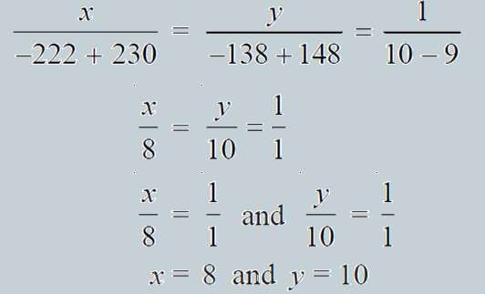


Examples
 2x + 3y – 46 = 0
3x + 5y – 74 = 0
Then,
(1)
(2)

Slide 18


Reducing an equation to Pair Of Linear Equation In Two Variable
This is done to equations which are not in form:-
For e.g. solving equation such as given below:-
…these are not in general form.

Slide 19



 In such case :-
Now we get the equation in general form i.e.
Now solve the equation using any method to get p=2 , q=3.
Substitute

Slide 20
Thank You

